Slide 1
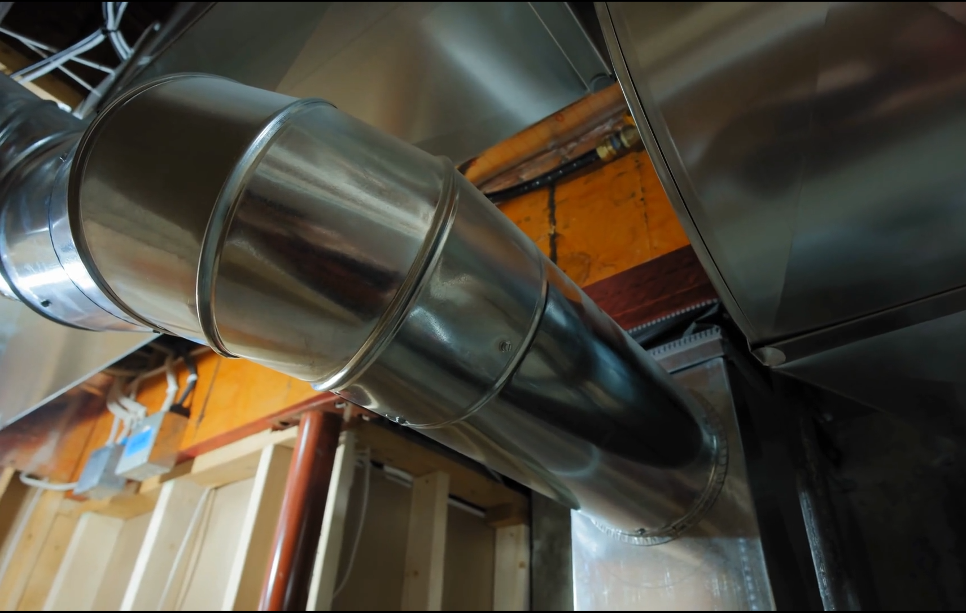
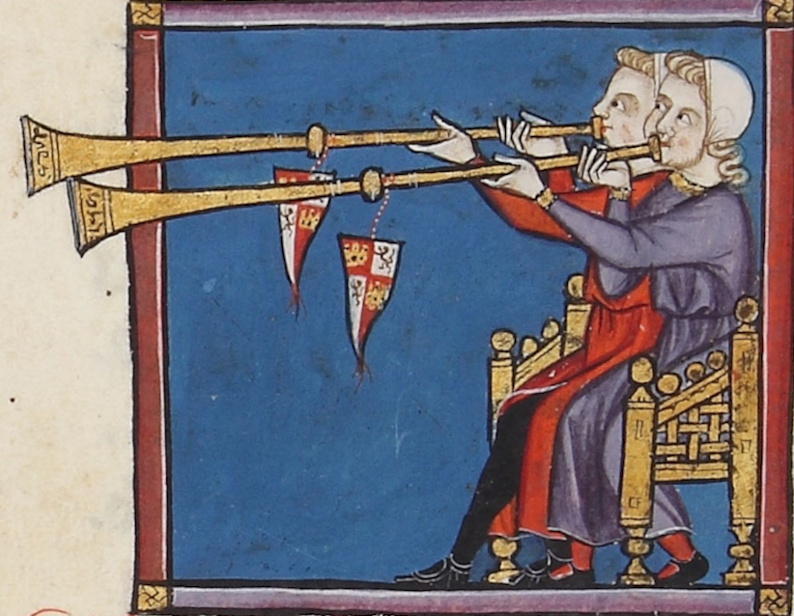
Ducts, Mufflers, and Silencers
Area changes and side branches
Tyler Dare

Slide 2

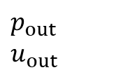
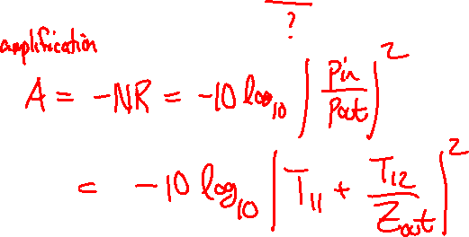
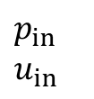
Example: acoustic horn
$p_{in}$
$u_{in}$
$p_{out}$
$u_{out}$
Three questions:
How does the shape of the horn affect the response?
Is there a “best” shape?
How should we quantify “best”?

Slide 3
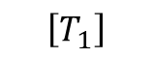
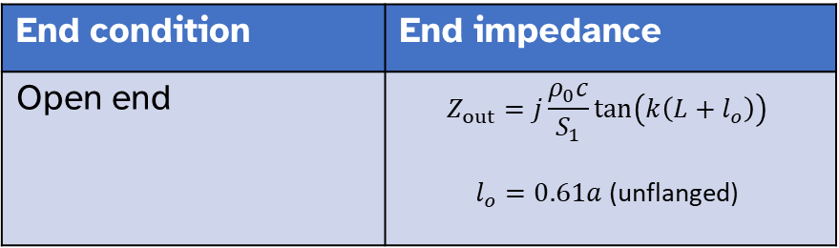
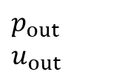

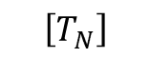
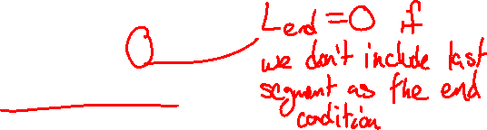
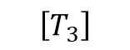
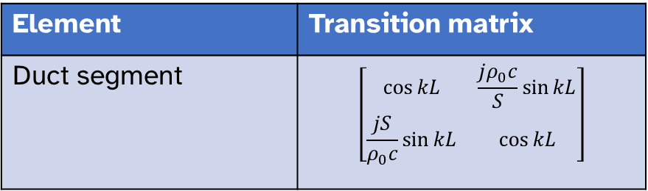
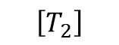
Example: acoustic horn
$p_{in}$
$u_{in}$
$p_{out}$
$u_{out}$
$$\left[T_{N}\right]$$
$$⋯$$
$$\left[T_{3}\right]$$
$$\left[T_{2}\right]$$
$$\left[T_{1}\right]$$
$\left\{\begin{aligned}p_{in} \\ {S_{in}u}_{in}\end{aligned}\right\}=\left[T_{N}\right]…\left[T_{2}\right]\left[T_{1}\right]\left\{\begin{aligned}p_{out} \\ {S_{out}u}_{out}\end{aligned}\right\}$ Matrices numbered outlet to inlet
Element | Transition matrix
Duct segment | $$\left[\begin{matrix}\cos{kL} & \frac{jρ_{0}c}{S}\sin{kL} \\ \frac{jS}{ρ_{0}c}\sin{kL} & \cos{kL}\end{matrix}\right]$$
End condition | End impedance
Open end | $$Z_{out}=j\frac{ρ_{0}c}{S_{1}}\tan\left(k\left(L+l_{o}\right)\right)$$ $l_{o}=0.61a$ (unflanged)

Slide 4
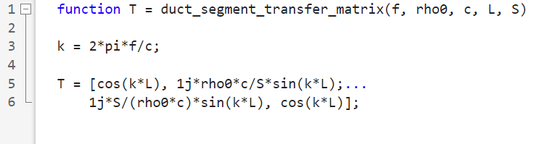
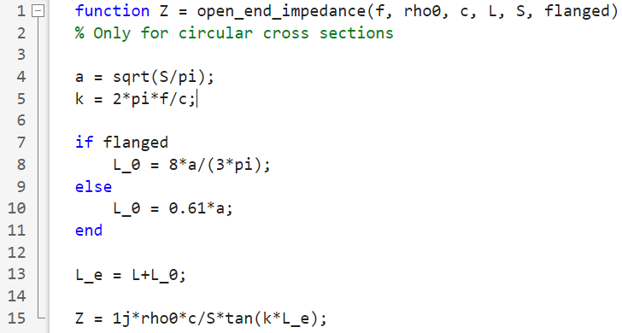
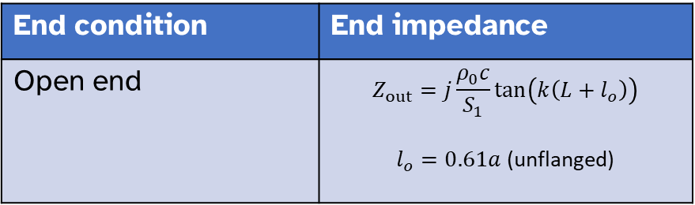
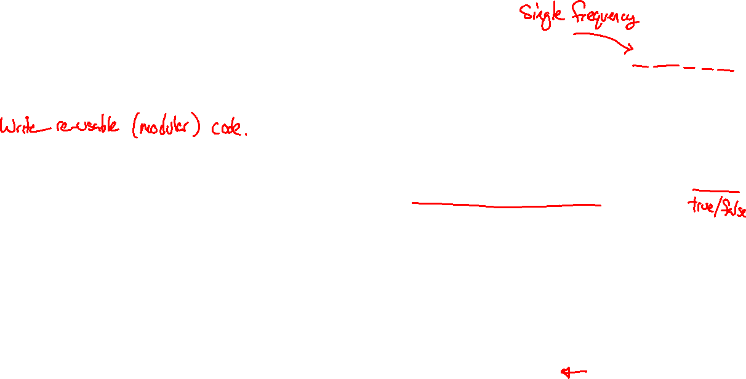
Example: acoustic horn
$p_{in}$
$u_{in}$
$p_{out}$
$u_{out}$
$$\left[T_{N}\right]$$
$$⋯$$
$$\left[T_{3}\right]$$
$$\left[T_{2}\right]$$
$$\left[T_{1}\right]$$
Element | Transition matrix
Duct segment | $$\left[\begin{matrix}\cos{kL} & \frac{jρ_{0}c}{S}\sin{kL} \\ \frac{jS}{ρ_{0}c}\sin{kL} & \cos{kL}\end{matrix}\right]$$
End condition | End impedance
Open end | $$Z_{out}=j\frac{ρ_{0}c}{S_{1}}\tan\left(k\left(L+l_{o}\right)\right)$$ $l_{o}=0.61a$ (unflanged)

Slide 5
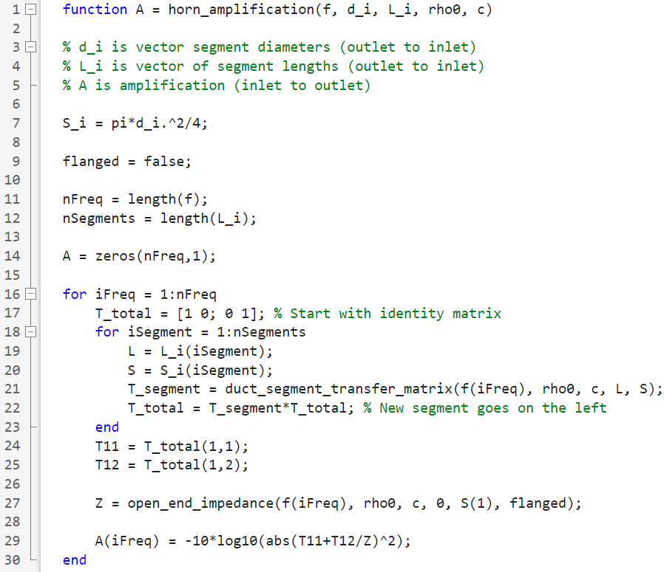
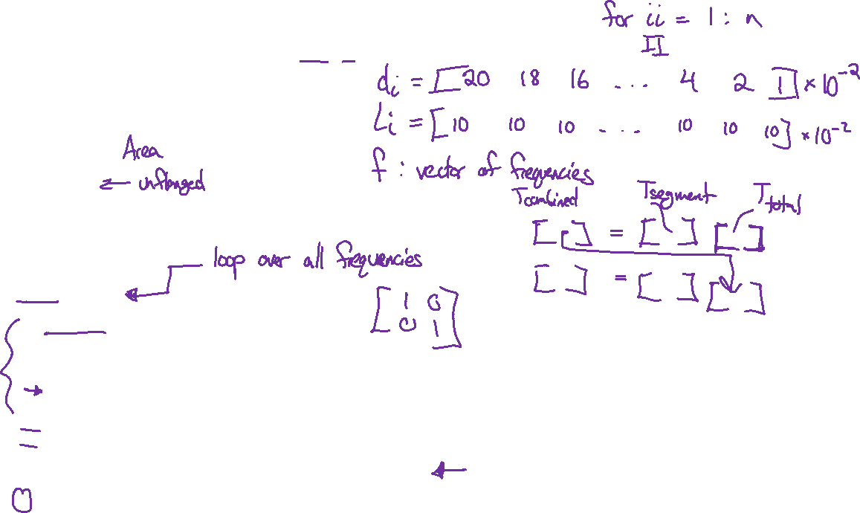
Example: acoustic horn

Slide 6
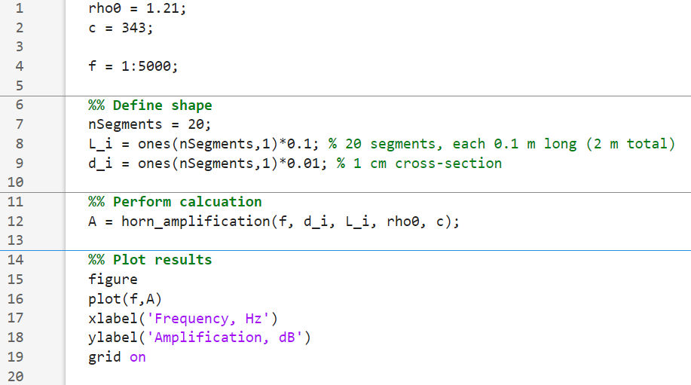
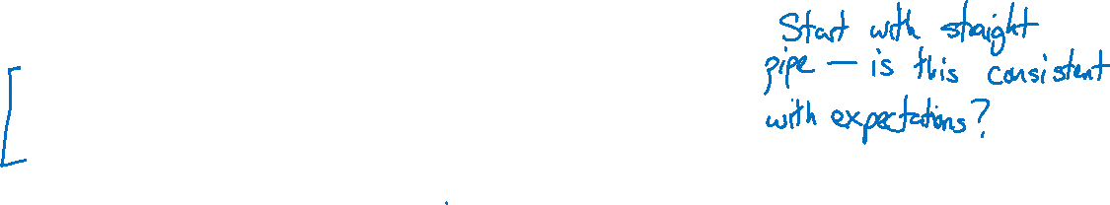
Example: acoustic horn

Slide 7
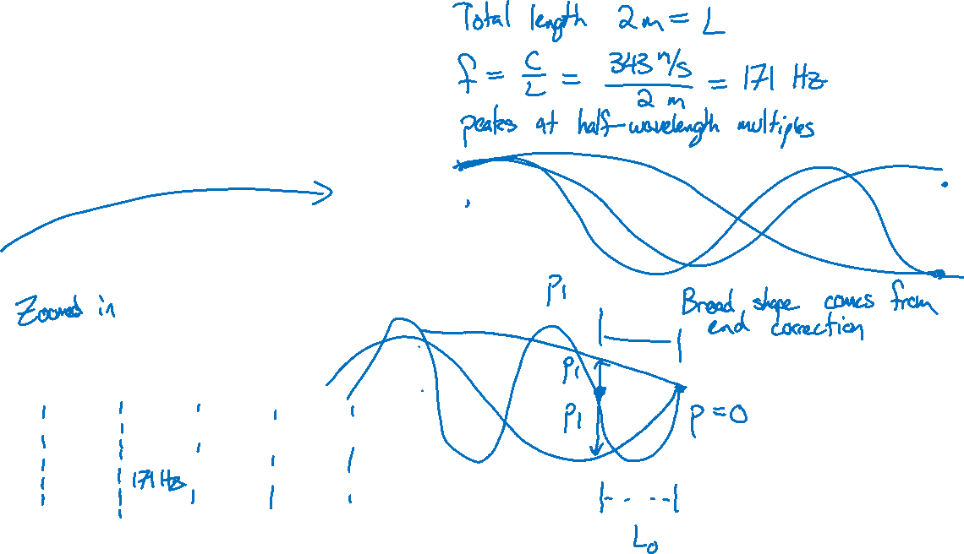
Example: acoustic horn

Slide 8
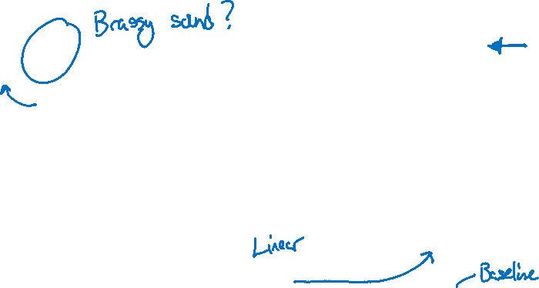
Example: acoustic horn

Slide 9
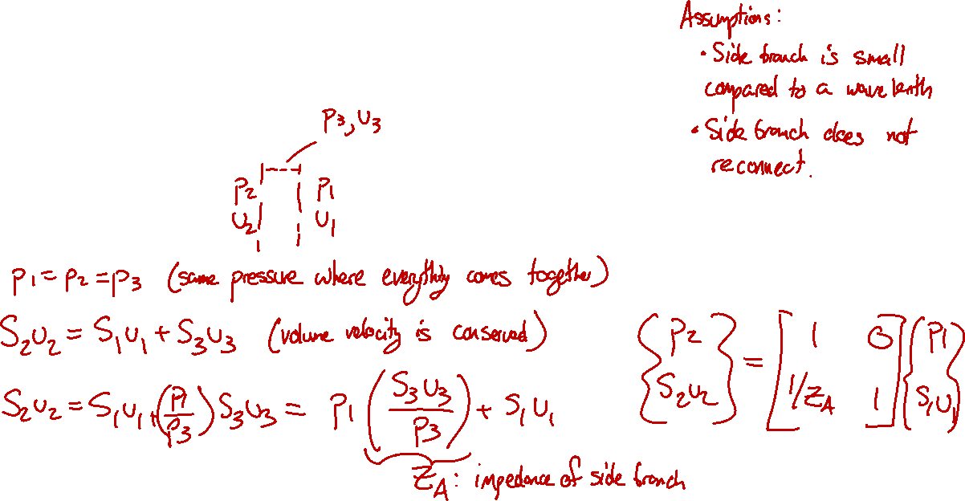
Side branches
How does a side branch affect the main duct’s acoustics?

Slide 10
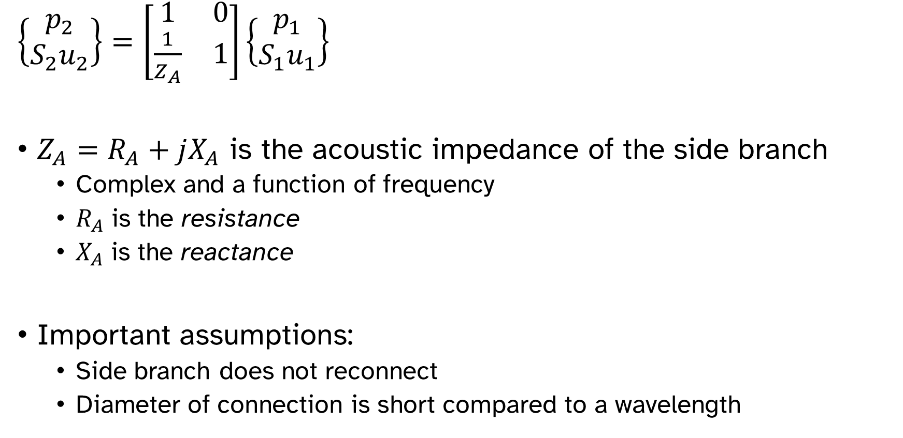

Side branches
$\left\{\begin{matrix}p_{2} \\ {S_{2}u}_{2}\end{matrix}\right\}=\left[\begin{matrix}1 & 0 \\ \frac{1}{Z_{A}} & 1\end{matrix}\right]\left\{\begin{matrix}p_{1} \\ {S_{1}u}_{1}\end{matrix}\right\}$
$Z_{A}=R_{A}+jX_{A}$ is the acoustic impedance of the side branch
Complex and a function of frequency
$R_{A}$ is the resistance
$X_{A}$ is the reactance
Important assumptions:
Side branch does not reconnect
Diameter of connection is short compared to a wavelength

Slide 11
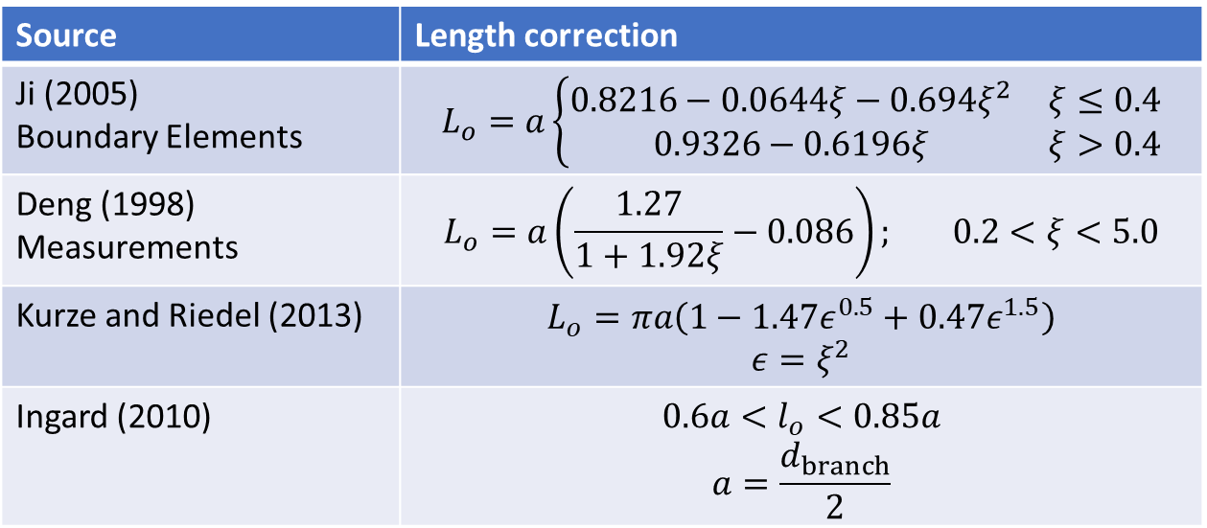
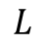
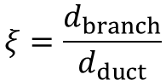
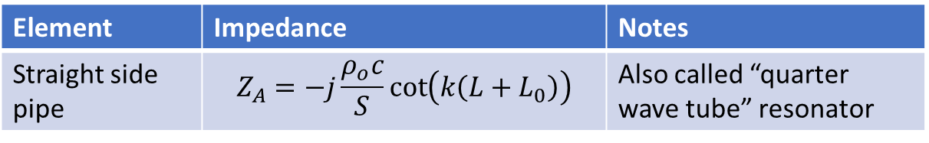
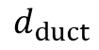
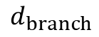
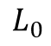
Side branch impedances
Element | Impedance | Notes
Straight side pipe | $$Z_{A}=−j\frac{ρ_{o}c}{S}\cot\left(k\left(L+L_{0}\right)\right)$$ | Also called “quarter wave tube” resonator
$$ξ=\frac{d_{branch}}{d_{duct}}$$
Source | Length correction
Ji (2005) Boundary Elements | $$L_{o}=a\left\{\begin{matrix}0.8216−0.0644ξ−0.694ξ^{2} & ξ≤0.4 \\ 0.9326−0.6196ξ & ξ>0.4\end{matrix}\right.$$
Deng (1998) Measurements | $$L_{o}=a\left(\frac{1.27}{1+1.92ξ}−0.086\right); 0.2<ξ<5.0$$
Kurze and Riedel (2013) | $$L_{o}=πa\left(1−1.47ε^{0.5}+0.47ε^{1.5}\right)$$ $$ε=ξ^{2}$$
Ingard (2010) | $$0.6a<l_{o}<0.85a$$ $$a=\frac{d_{branch}}{2}$$
$$d_{branch}$$
$$L$$
$$L_{0}$$
$$d_{duct}$$

Slide 12
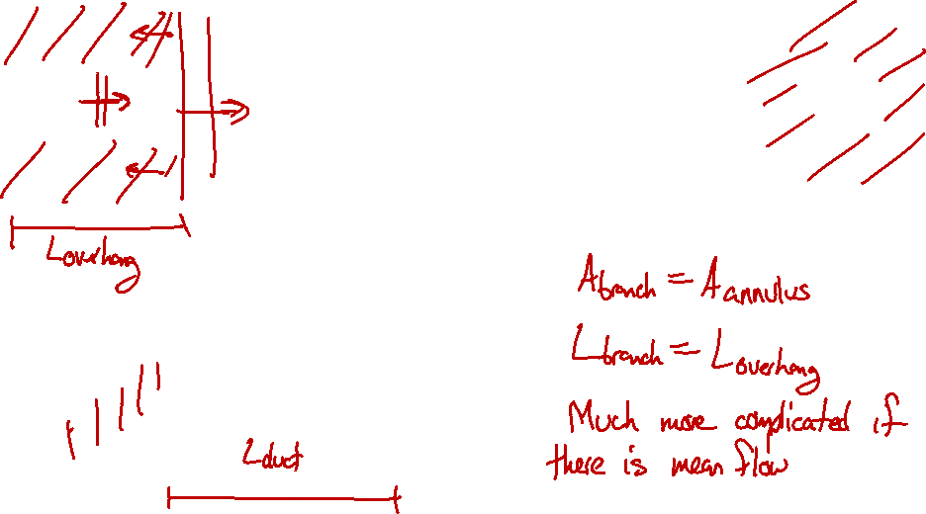
Side branch impedances
Pipe extension into expansion chamber acts as a side branch

Slide 13
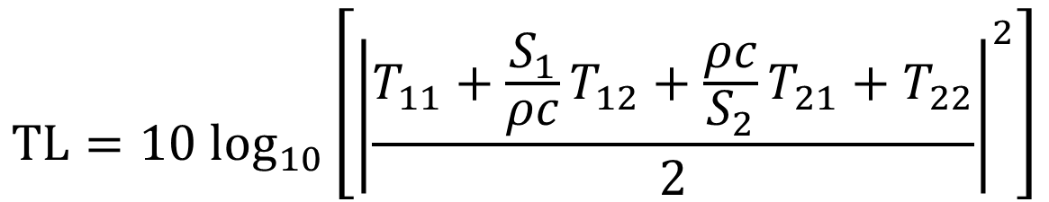
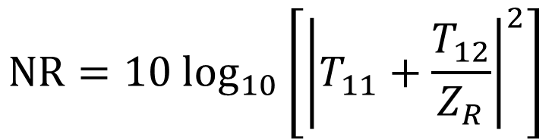
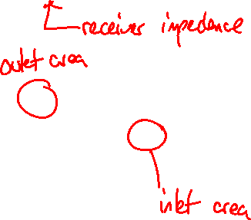
Calculating performance metrics from transfer matrix
$$NR=10 \log_{10}\left[{\left|T_{11}+\frac{T_{12}}{Z_{R}}\right|}^{2}\right]$$
$$TL=10 \log_{10}\left[{\left|\frac{T_{11}+{\frac{S_{1}}{ρc}T}_{12}+\frac{ρc}{S_{2}}T_{21}+T_{22}}{2}\right|}^{2}\right]$$

Slide 14
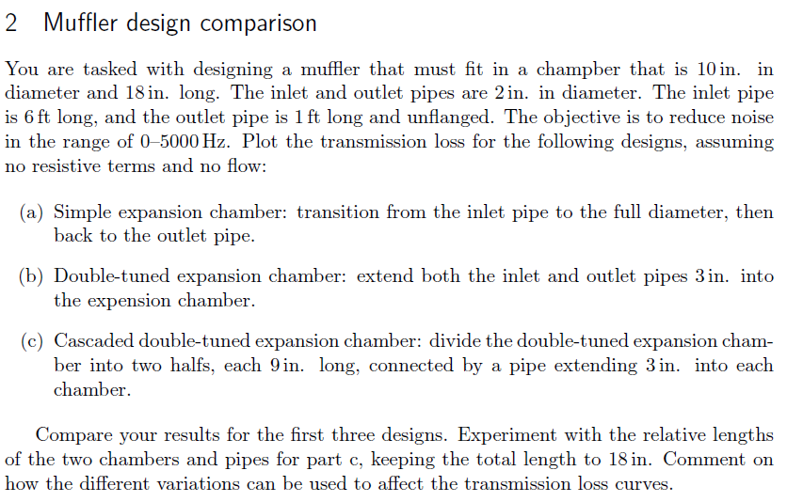
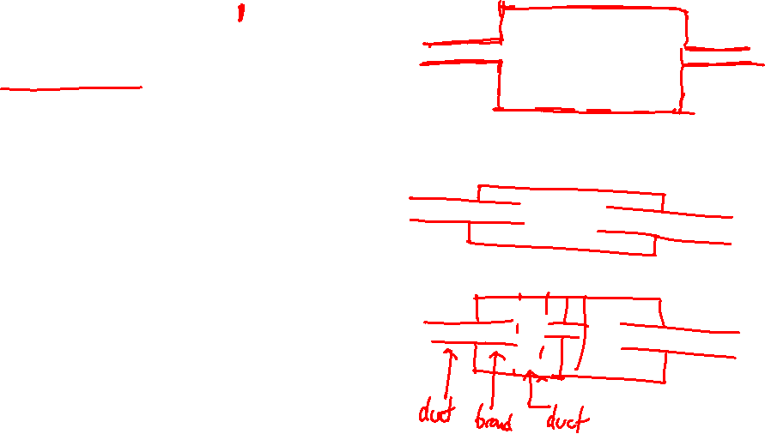

Slide 15
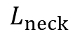
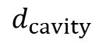
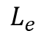
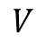
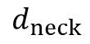
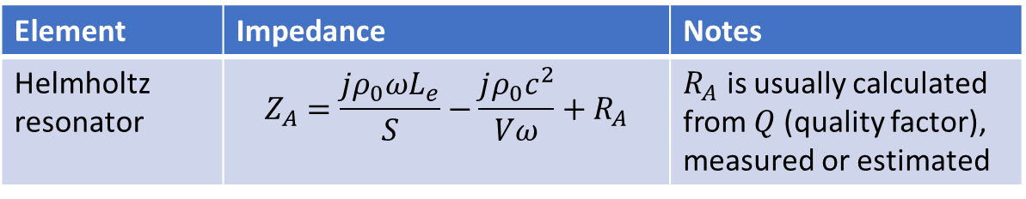
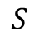
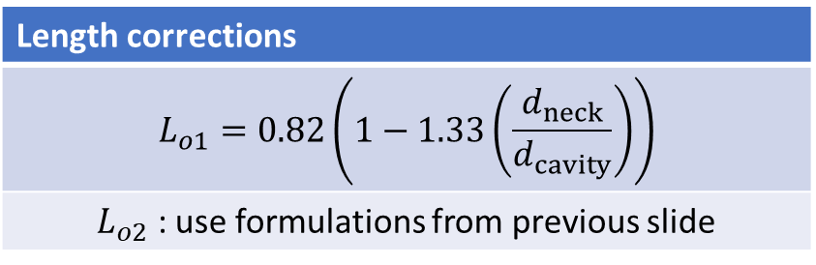
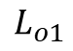
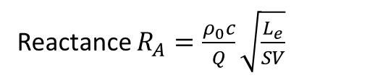
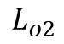
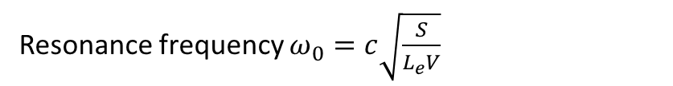
Side branch impedances
Element | Impedance | Notes
Helmholtz resonator | $$Z_{A}=\frac{jρ_{0}ωL_{e}}{S}−\frac{jρ_{0}c^{2}}{Vω}+R_{A}$$ | $R_{A}$ is usually calculated from $Q$ (quality factor), measured or estimated
Resonance frequency $ω_{0}=c\sqrt{\frac{S}{L_{e}V}}$
$$d_{cavity}$$
$$V$$
Reactance $R_{A}=\frac{ρ_{0}c}{Q}\sqrt{\frac{L_{e}}{SV}}$
$$L_{o1}$$
Length corrections
$$L_{o1}=0.82\left(1−1.33\left(\frac{d_{neck}}{d_{cavity}}\right)\right)$$
$L_{o2}$ : use formulations from previous slide
$$L_{neck}$$
$$S$$
$$L_{e}$$
$$L_{o2}$$
$$d_{neck}$$

Slide 16





Side branch impedances
Element | Impedance | Notes
Orifice | $$Z_{A}=\frac{jρ_{0}ωL_{e}}{S}+R_{A}$$ | $R_{A}$ is complicated…
$$L_{o}$$
Length corrections
$L_{e}=w+2L_{o}{\left(1−M\right)}^{2}$, $M$ is Mach number of flow through the orifice
$L_{o}$ : use formulations from previous slides
$${w=L}_{neck}$$
$$S$$
$$L_{e}$$
$$L_{o}$$
$$d_{neck}$$

Slide 17



Side branch impedances
Element | Impedance | Notes
Orifice | $$Z_{A}=\frac{jρ_{0}ωL_{e}}{S}+R_{A}$$ | $R_{A}$ is complicated…
$$R_{A}=\frac{ρc}{S}\left[\frac{kδ_{μ}Dw}{2S}\left(1+\left(γ−1\right)\sqrt{\frac{5}{3γ}}\right)+0.288kδ_{μ}\log_{10}\left[\frac{4S}{πh^{2}}\right]+ε\frac{Sk^{2}}{2π}+0.7M\right]$$
$δ_{μ}=\sqrt{\frac{2μ}{ωρ}}$ : viscous boundary layer thickness
$D$: cross-sectional perimeter
$S$: cross-sectional surface area
$γ=1.4$: ratio of specific heats
$h$: larger of $w/2$ or $δ_{μ}$ for plates of negligible thickness ($w≈0$)
$h$: larger of edge radius or $δ_{μ}$ for tube openings where ($w≫0$)
$ε = 0$ for tubes radiating into spaces smaller than a wavelength (e.g., expansion tube)
$ε = 1$for flanged open radiation from a tube
$ε = 0.5$for unflanged open radiation from a tube
$ε = 2$ for radiation into a quarter wave tube or Helmholtz resonator
$M$: Mach number for flow though hole

Slide 18

Side branch impedances
Element | Impedance | Notes
Orifice | $$Z_{A}=\frac{jρ_{0}ωL_{e}}{S}+R_{A}$$ | $R_{A}$ is complicated…
$$R_{A}=\frac{ρc}{S}\left[\frac{kδ_{μ}Dw}{2S}\left(1+\left(γ−1\right)\sqrt{\frac{5}{3γ}}\right)+0.288kδ_{μ}\log_{10}\left[\frac{4S}{πh^{2}}\right]+ε\frac{Sk^{2}}{2π}+0.7M\right]$$
Accounts for attenuation along the length of the tube (Negligible for small tube lengths)
Accounts for mean flow through the orifice from grazing flow and for $M<0.2$
If flow is through orifice use $2.7M$
For high SPL, use $2.7M$ where $M$ is the Mach number of the acoustic particle velocity
Accounts for viscous losses at the tube entry
Accounts for radiation losses at the tube exit

Slide 19





Source impedance
The source has its own impedance as well
$p_{in}$
$S_{in}u_{in}$
$p_{out}$
$S_{out}u_{out}$
$$Z_{src}=\frac{p_{in}}{S_{in}u_{in}}$$
$$Z_{out}=\frac{p_{out}}{{S_{out}u}_{out}}$$
$Z_{src}→∞$ if velocity is prescribed (piston-driven)
$Z_{src}$ is hard to predict, but can be measured experimentally
If $Z_{src}$ is low, it takes a lot of pressure to make a given amount of velocity

Slide 20




All of the impedances act together
$p_{in}$
$S_{in}u_{in}$
$p_{out}$
$S_{out}u_{out}$
$$Z_{src}=\frac{p_{in}}{{Su}_{in}}$$
$$Z_{out}=\frac{p_{out}}{{S_{out}u}_{out}}$$
$$\left\{\begin{aligned}p_{in} \\ {S_{in}u}_{in}\end{aligned}\right\}=\left[T_{duct}\right]\left[T_{branch}\right]…\left[T_{2}\right]\left[T_{1}\right]\left\{\begin{aligned}p_{out} \\ {S_{out}u}_{out}\end{aligned}\right\}$$

Slide 21


Calculating performance metrics from transfer matrix
$$IL=10 \log_{10}\left[{\left|\frac{Z_{s}T_{11}+T_{12}+Z_{s}Z_{R}T_{21}+Z_{s}T_{22}}{Z_{s}\tilde{T_{11}}+\tilde{T_{12}}+Z_{s}Z_{R}\tilde{T_{21}}+Z_{s}\tilde{T_{22}}}\right|}^{2}\right]$$
$$IL=20 \log_{10}\left[\left|\frac{Z_{R}T_{21}+T_{22}}{Z_{R}\tilde{T_{21}}+\tilde{T_{22}}}\right|\right]$$

Slide 22



